Slide 1

Nuclear Power Looking Forward:
the Opportunity and the Implications
Bob Coward
President-Elect
American Nuclear Society
Spring 2017

Slide 2

Topics for Today
Perspective
Situation
Opportunity
Implications
And then let’s talk some…

Slide 3
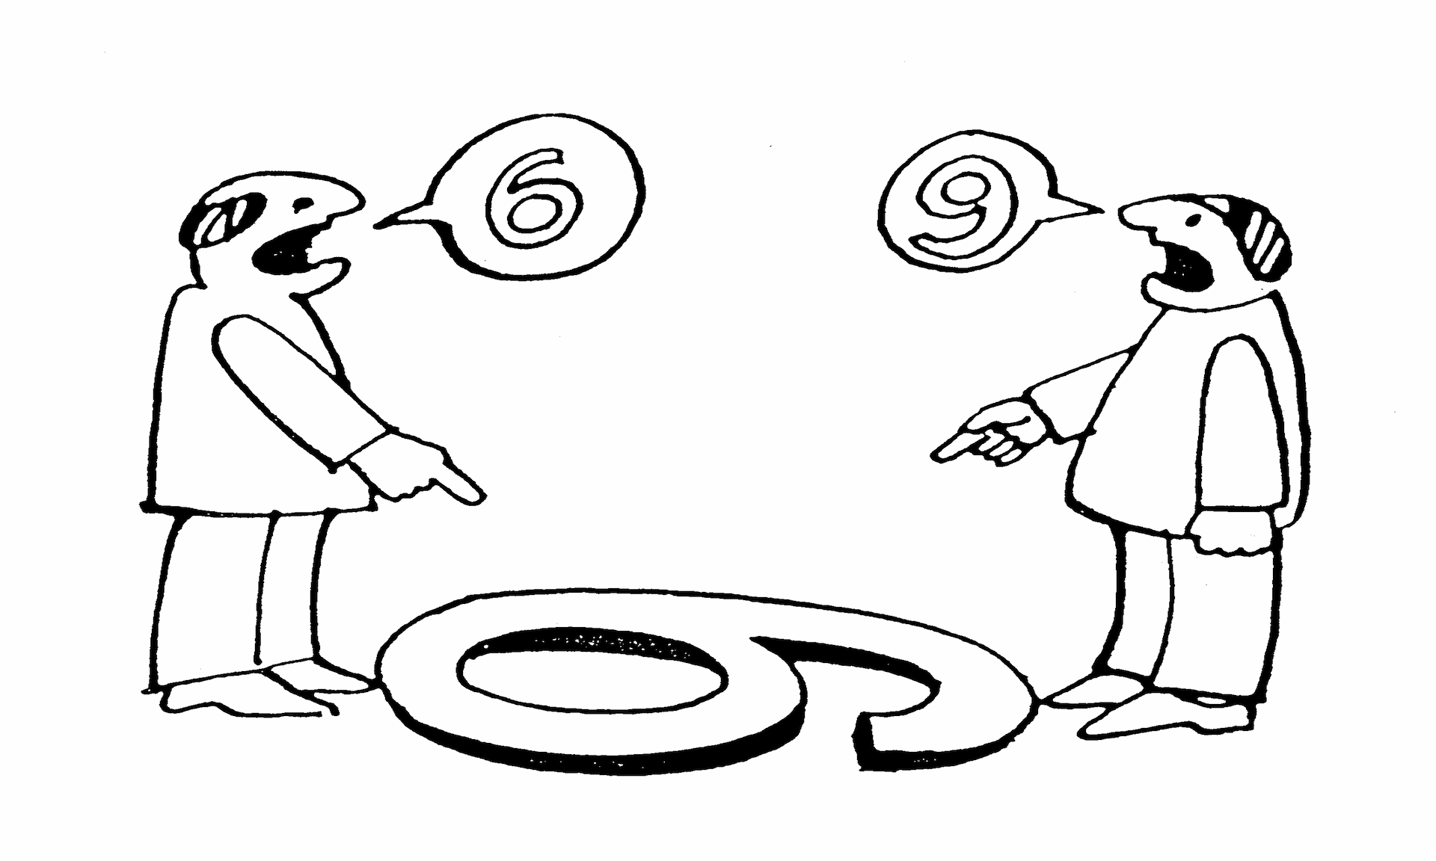
Perspective
What Frames My Views?

Slide 4

Perspective – Where I Come From
Principal Officer (co-President) of MPR – a world leading specialty engineering and project management services company
We provide high value and innovative engineering and project/risk management solutions to domestic and international clients in:
  Energy
  Defense & National Security
  Health & Life Sciences
We work for:
  Every US nuclear power plant
  Numerous others world-wide
  All major NSSS vendors and many other industry companies
  DOE and DOD

Slide 5
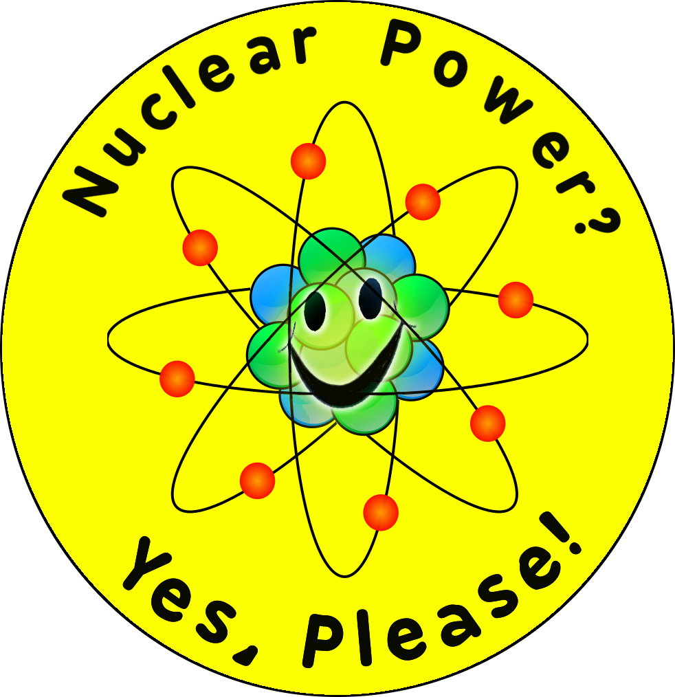
Perspective – Where I Come From
MPR was founded by the chief leaders of Admiral Rickover’s organization
  They developed the Naval Nuclear Propulsion Program
  as well as first commercial nuclear power plant
MPR was there at the beginning of the nuclear
industry, has remained there for 50+ years,
and it is still our primary business focus today
The founders instilled a culture that remains
today:
  Technical Rigor
  Discipline
  Integrity
We own, safeguard, and apply the Rickover legacy for excellence
I’m a “nuclear power guy”, and have been my entire career:
A believer in it’s benefits and the potential for even more
Proud of the industry I help lead

Slide 6

Situation
Where do Things Stand Today?

Slide 7

Two Ways to Look Life?
Looking Up
The numbers:
  450 operating reactors in
  30 countries
  60 under construction in
  15 countries
The interest:
  US political interest highest in decades
  Growing interest in SMRs
  Especially strong interest in Advanced Reactors
Value:
  Increasing appreciation for value of nuclear to climate and health, and as economic engines
Anxious
The numbers:
  6 US reactors recently closed
  4 more closures planned
  ~10+ threatened
The trends:
  Long term natural gas prices remain low
  Renewable subsidies continue to impact markets
  Struggles to execute new builds
Value:
  Do policy makers care enough to set needed priorities?

Slide 8

Climate Change (my conclusions) ?
Earth is likely in a normal periodic warming cycle, and will get warmer –> independent of humans
Humans (i.e., emissions) are likely contributing
to warming of the Earth –> independent of normal/periodic effects
Combination of these two phenomena
could lead to significant warming …
and potential for catastrophic effects
Even with questions regarding the reality of anthropogenic climate change, the potential consequences are so large that proactive action is warranted

Slide 9
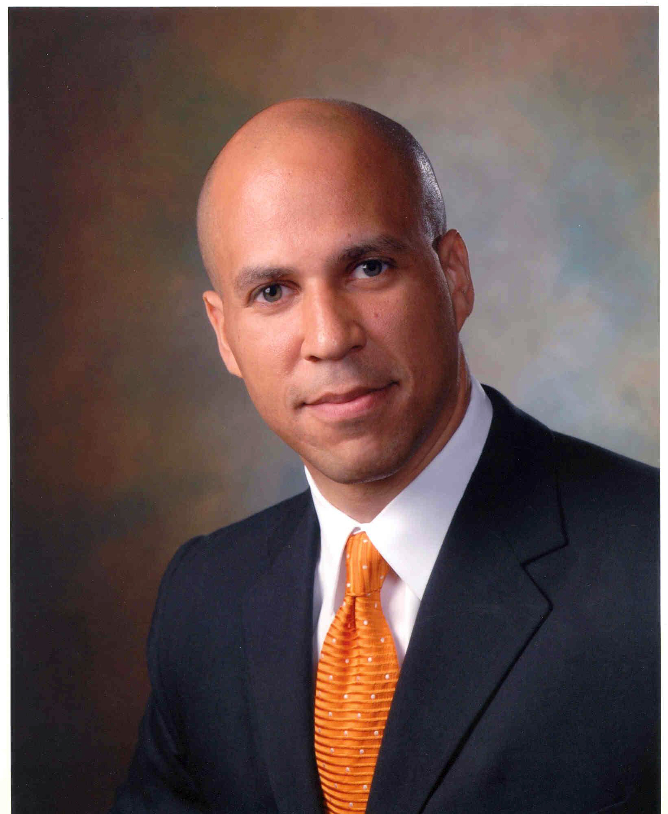
Don’t Forget About the Air We Breathe
“And so the cleaner and safer future depends, in my opinion, on having carbon neutral power, baseload power...
We have to be a country that steps up and says it has to be
renewable new advanced nuclear energy. It has to be there if by 2050 we are to be a carbon neutral country.
For me, this is about the kids in my city. For me, this is about kids in Camden and Patterson who are suffering not just because we have a polluted atmosphere, but it’s also about creating an America for them that is bold and courageous again…”
Beyond climate change, nuclear power also improves the air around us, setting the foundation for an improved standard of living for everyone

Slide 10


COP 21 (2015 Paris Agreement)
All countries pledge to pursue all measures
to limit Earth’s temperature rise to <2°C,
while aspiring to <1.5°C
Each country will provide a
detailed, structured plan to reduce
CO₂ emissions every year
The developed world will assist
developing countries to achieve their
targets, including financial,
technological, or other support

Slide 11
Why is it Important?

Slide 12
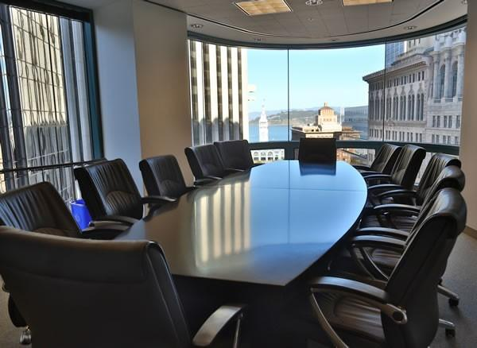
View from the Boardroom
Reality We Can’t Ignore:
  US Nuclear Power Plants becoming
  non-competitive in “energy-only” markets
    additional shut-downs likely
  Struggles to complete new build projects
    particularly Westinghouse and Areva
  Projects deferred around the globe
  Toshiba/Westinghouse financial meltdown
-> Evolving perception of “nuclear is good for environment,
but perhaps bad business”
Signs of success:
  Illinois and New York programs
  UAE Nuclear Power Program
  Continued overall success in Korea
  SMRs as mitigation to some of the
  financial challenges facing large plants
We need to fight back the perception by building on our successes and delivering on our commitments

Slide 13

Don’t Forget, there was a US Election
The November 2016 election and actions since have raised questions regarding priorities of the US Federal government related to energy and environment
  President Trump has backed away from climate change goals in favor of fossil fuels
  Strong support remains in Congress for nuclear energy, particularly advanced nuclear power
Prevailing opinion is that the opportunity and need for advanced nuclear remains
  However, the US priority could be lower than industry desires
The President and a majority of Congress are pro-nuclear; however, achieving the needed changes in policy and associated priorities continues to be elusive

Slide 14


Leaving Us …

Slide 15



Why Should we be Excited?

Slide 16

Opportunity
What is Possible (and Needed)?

Slide 17
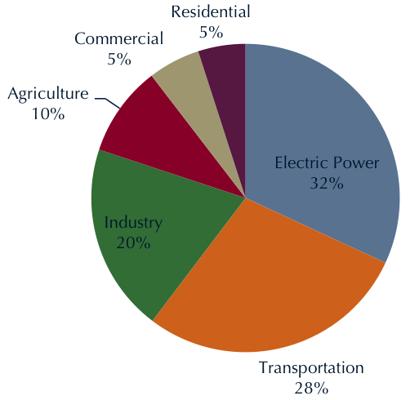
Sources of Greenhouse Emissions (US)
X
X
X

Slide 18
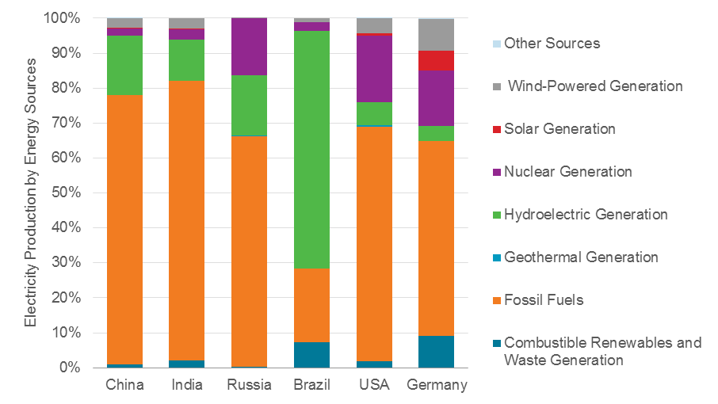
Electricity Production Sources
X
X
X
X
X
X

Slide 19
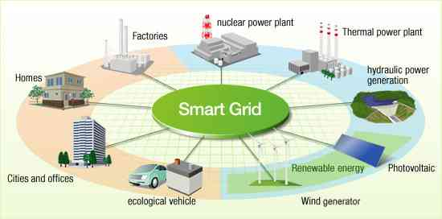
Opportunity and Need
One, or more likely, both of two things must occur to achieve emission goals (in US and world-wide):
  Significant expansion of nuclear power
  Orders of magnitude advances in energy storage and energy delivery
“Advanced Nuclear” is widely
considered a key opportunity
to anchor the grid of the future
Aging infrastructure must be
addressed in parallel with
implementing new technology
Balancing technology development, reliability, cost, safety, and NIMBY, BANANA, and NOPE issues will be critical

Slide 20
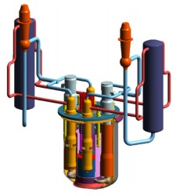
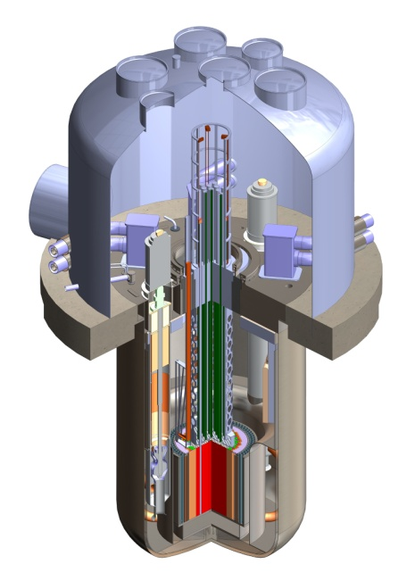
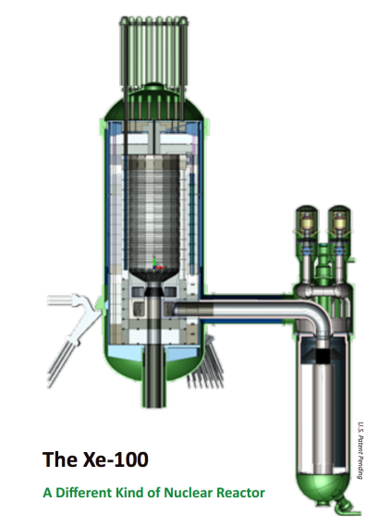
Advanced Reactors
Currently a “bright shiny object” in Washington
  Wide and strong bi-partisan support
  (by Washington standards)
  Seen as foundation element of effort to reduce
  emissions and clean air
What is an “Advanced Reactor”?
  Gas cooled, sodium cooled, molten salt,
  very high temperature gas, super-critical
  water?
  Typically:
    “Walk away safe”
    High temperature (500° - 900°C)
    Proliferation resistant
    Heat applications in addition to electricity generation
    Many low pressure
    Many closed fuel cycle
Little to no regulatory infrastructure in place
Goal: “Half the cost, twice as fast”

Slide 21
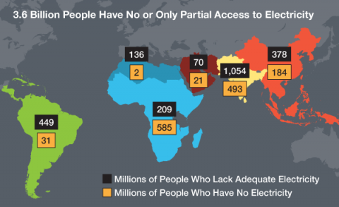
But the Challenge is Even Greater…

Slide 22
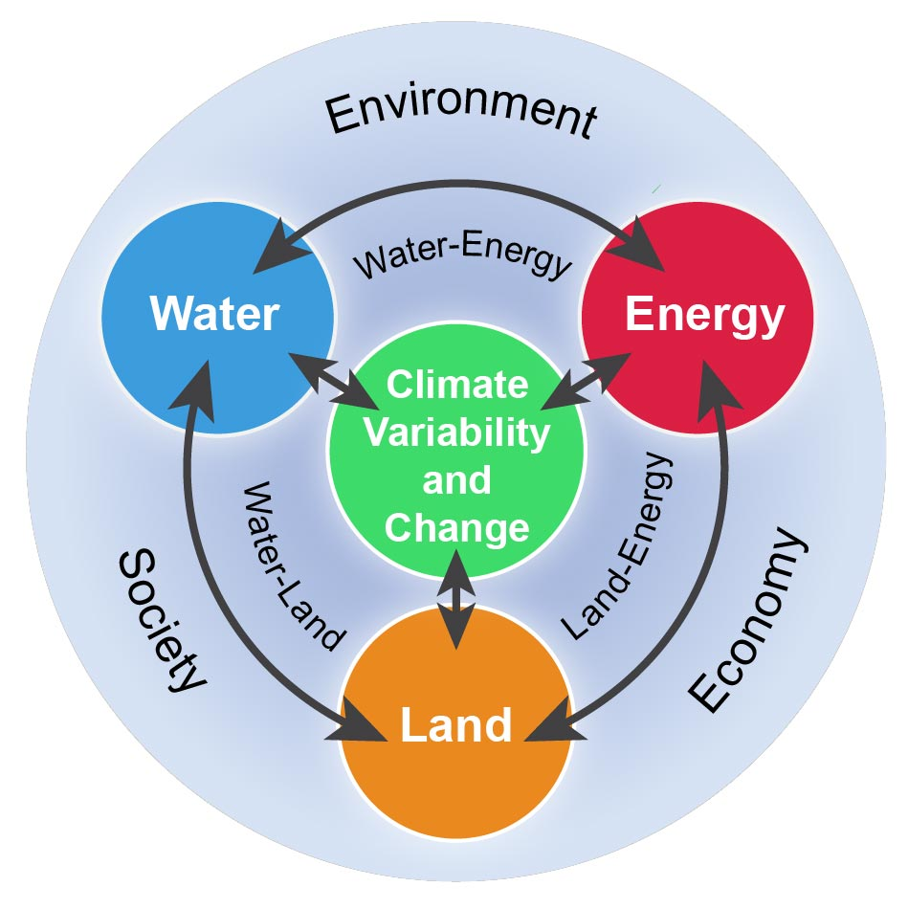
Looking for Solutions
There is a complex relationship between:
  Energy
  Environment
  Water
  Food
  Land Use
We must balance these competing factors to achieve sustainable access to all needed resources
As stewards, we must consider all aspects of how we use our resources effectively and sustainably

Slide 23
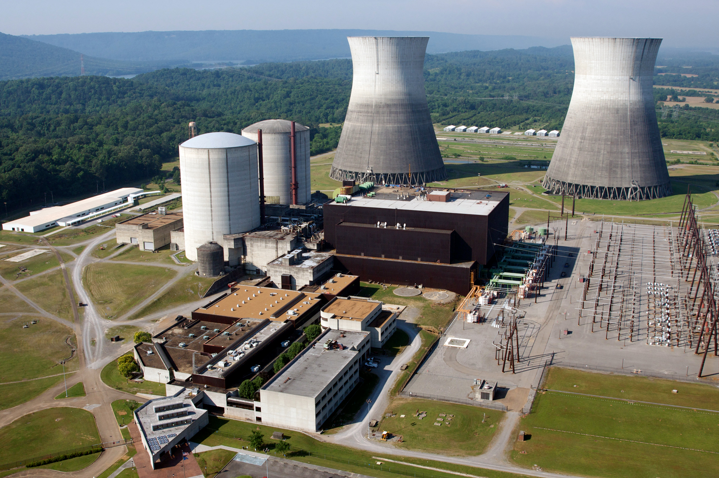
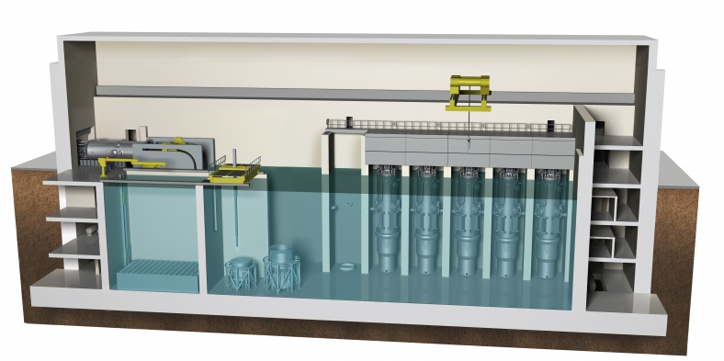
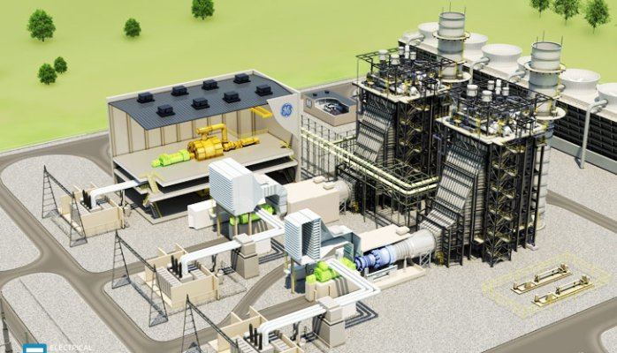
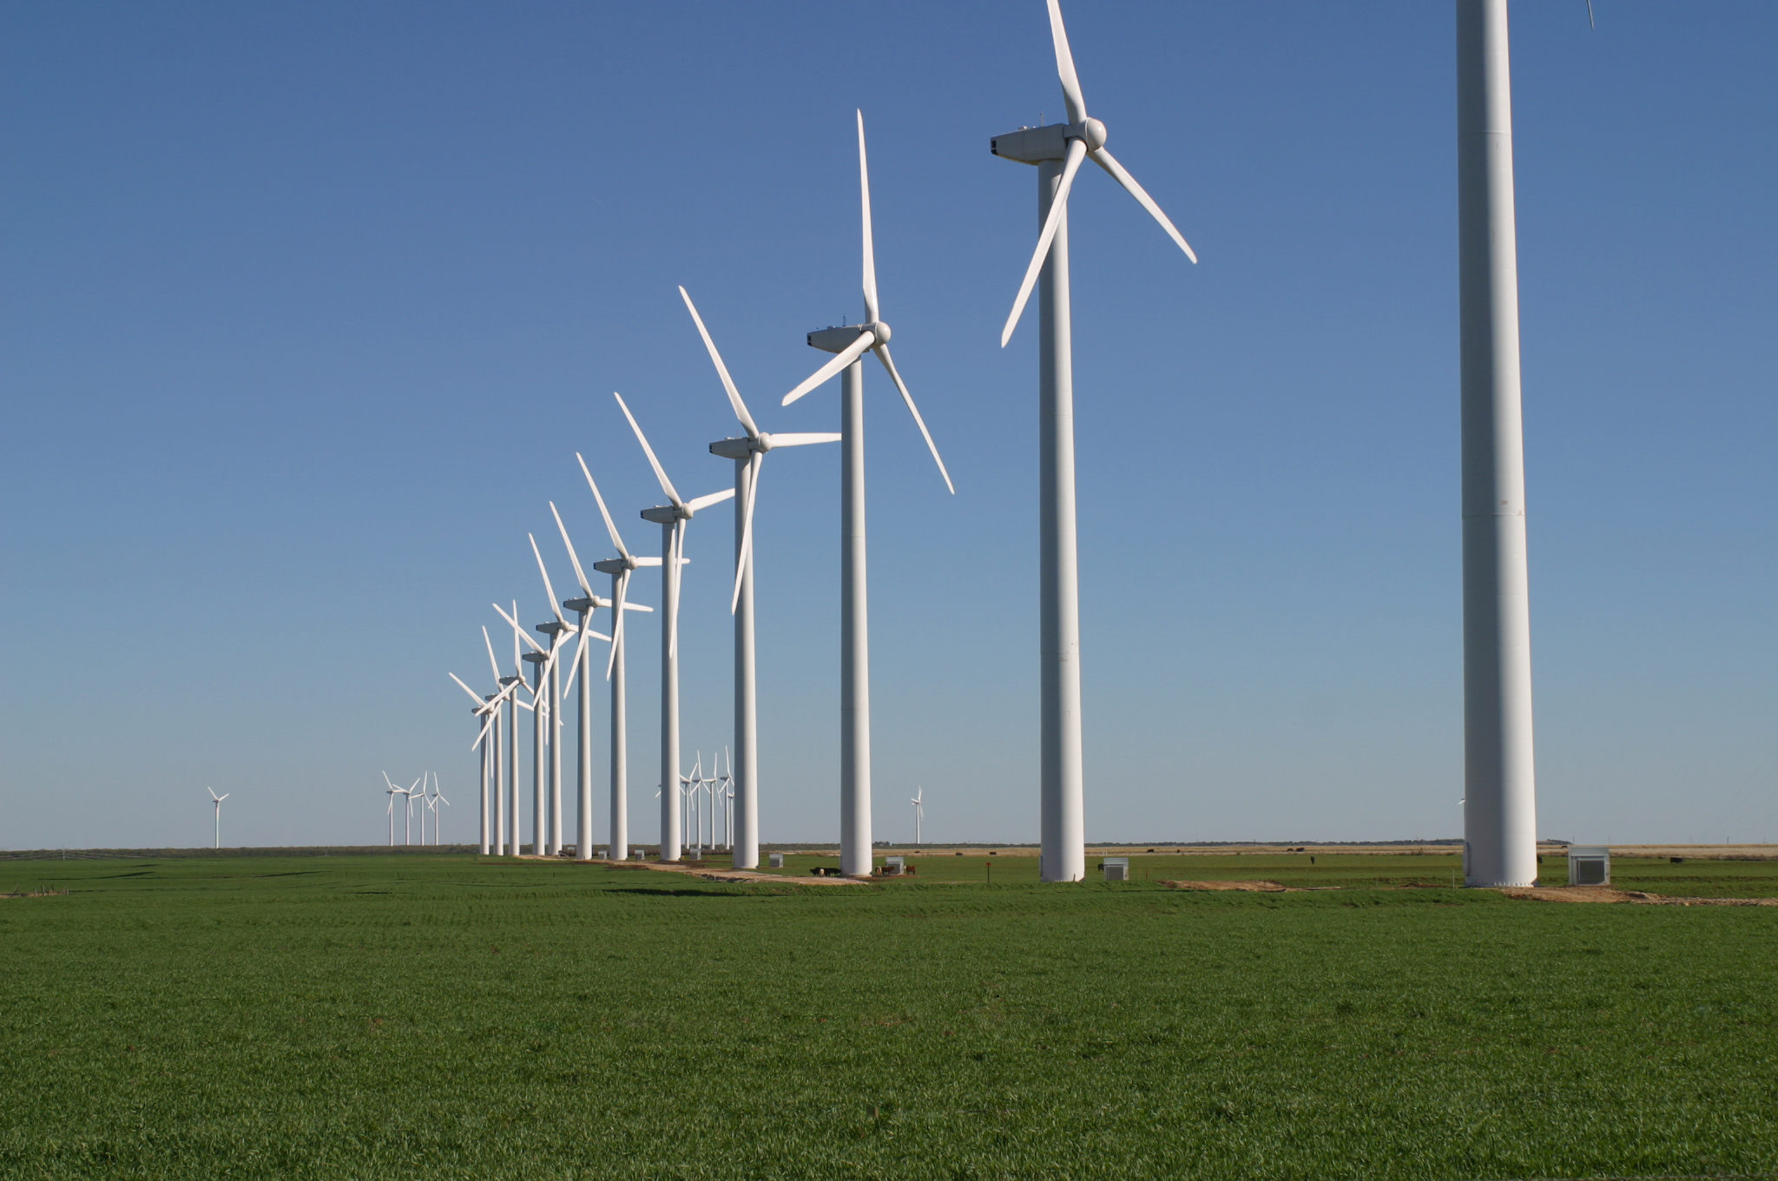

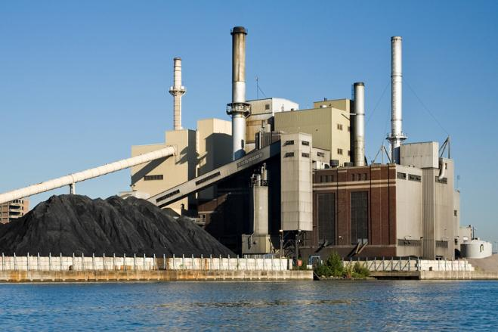
5,000 MWe ?
3 or 4 “large” nuclear reactors | 15 to 100 SMRs | 5 to 8 combined cycle plants
1670 to 2500 Wind Turbines (over 300 to 400 miles²) | 40 to 50 miles² of solar panels | 5 to 8 coal boilers

Slide 24

Implications
What Does This Mean to Us?

Slide 25
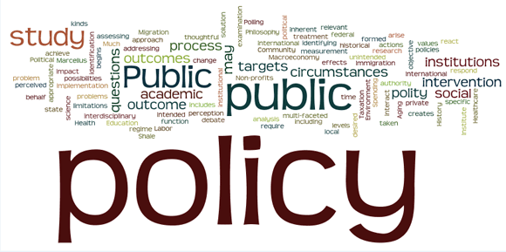
Creating the Future – Big Picture Policy
Aggressively take action to fix dysfunctional electricity markets – without a thriving industry today, we won’t capture our future opportunity
Take a more “Societal Approach”
focused on challenges and benefits
  Recognize the strategic and long term
  benefits of nuclear power
  Increase efforts to promote/stimulate
  energy companies to collaborate on new plant projects to share the risks and benefits
  Consider incentives and programs to ease the cash flow challenges
Fully evaluate the ability of SMRs to address the challenges and then deploy them with confidence on a broad scale
Complete the needed R&D and infrastructure to support advanced reactors, and move forward to implementation

Slide 26

Creating the Future – You and Me
This is a “Leadership Moment” – embrace it and influence those around you
We need to be aligned and coordinated… and understand the big picture
This will be long and hard,
so it is important to:
  Have patience
  Be diligent
  Stay on task
  Stay on message
  Be a team
Deliver on commitments – build trust, then build more trust!
Continue to grow as professionals:
  Learn and experience
  Improve communication and leadership skills
  Adapt and apply yourself

Slide 27

Why is This So Damn Important?
Nuclear power plants provide important benefits and address equally important national challenges:
  Economic engines
  Climate/environment
  Energy independence
  Diversity of energy resources
  Stability and reliability of the
  electric grid
  Predictability of electricity costs
  National Security
As leaders in industry and our communities, we have the obligation to make investment decisions for the best overall approach for long term energy & environment stewardship
We need to create the future for nuclear power and we need to be successful… Together!

Slide 28

“If you want to go fast, go alone,
if you want to go far, go together”
African Proverb

Slide 29
Discussion
?

